Slide 1
Modular Arithmetic

Slide 2
Output the answer modulo 10^9+7
Prerequisities
What is Modulo?
The modulo operation is the same as ‘ the remainder of the division ’. If I say a modulo b is c, it means that the remainder when a is divided by b is c.
Represented by the ‘%’ operator.
So, 5 % 2 = 1, 17 % 5 = 2, 7 % 9 = 7 and so on.

Slide 3
Why modulo is needed?
The largest integer data type in C/C++ is the long long int; its size is 64 bits and can store integers from ( –2^63 ) to ( +2^63 -1 ) . Integers as large as 9 X 10^18 can be stored in a long long int.
For instance, Permutations of a size n
N! = n x n-1 x n-1 x ……. X 3 x 2 x 1
for n=21, the answer is 21! which is about 5 x 10^19 and too large for a long long int variable to store. This makes calculating values of large factorials difficult.

Slide 4
So, instead of asking the exact value of the answer, the problem setters ask the answer modulo some number M; so that the answer still remain in the range

Slide 5
A few distributive properties of modulo are as follows: 1. ( a + b ) % c = ( ( a % c ) + ( b % c ) ) % c 2. ( a * b ) % c = ( ( a % c ) * ( b % c ) ) % c 3. ( a – b ) % c = ( ( a % c ) – ( b % c ) ) % c So, modulo is distributive over +, * and –.

Slide 6
It doesn’t make any difference if we first multiply all numbers and then modulo it by M, or we modulo at each stage of multiplication. ( a * b * c ) % M is the same as ( ( ( a * b ) % M ) * c ) % M
Or (a+b+c)%M is same as ( ( (a+b)%M ) + c )%M

Slide 7
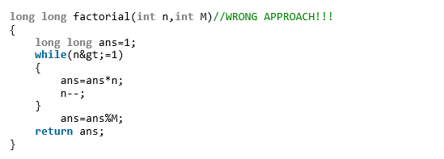
Perform modulo M at each intermediate stage so that range overflow never occurs.

Slide 8
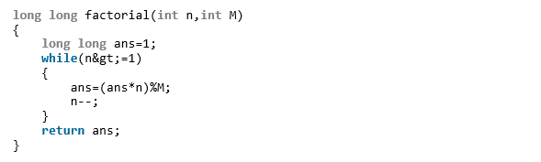
Right!

Slide 9
Subtraction
( a – b ) % c = ( ( a % c ) – ( b % c ) ) %c is fine mathematically. But, while programming, don’t use this
a = a%c;
b=b%c;
ans=(a-b)%c;
Instead use :
a = a%c;
b = b%c;
ans = (a-b+c)%c

Slide 10
Division
The rules are a little different for division.
( a / b ) % c NOT EQUAL TO ( ( a % c ) / ( b % c ) ) % c which means that modulo operation is not distributive over division.
For (a/b) , first find multiplicative inverse of b then multiply with a
That is,
(a/b)%Mod =( a x multiplicative inverse of (b) ) % Mod
// (a / b) mod p = ((a mod p) * (b^(-1) mod p)) mod p Where b^(-1) mod p is the modular inverse of b mod p. For p = prime, b^(-1) mod p = b^(p - 2) mod p.

Slide 11
To find multiplicative inverse
Multiplicative inverse of b is
MMI = fastpower(b,MOD-2);
MOD should be a prime number
Then
(a/b)%MOD = ( a X MMI ) %MOD

Slide 12
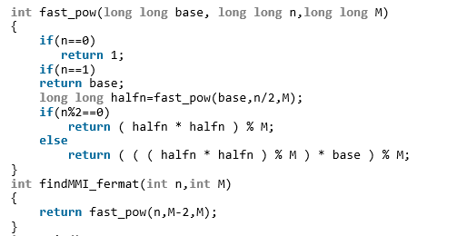
Int MMI = findMMI_fermat(b,MOD);
Ans = ( a x MMI ) % MOD

Slide 13
Find it here:
https://codeaccepted.wordpress.com/2014/02/15/output-the-answer-modulo-109-7/

Slide 14
To Find Modulus to a very very large number
Sometimes we need to find modulus of a very large number of 100+ digits like
2345187169816171987877167128926711……………………………………
?

Slide 15
How? No Data TYPE BiG enough available?
Input the number in the character array
Char ch[1000] ;
Scanf(“%s”,ch);
Then : follow this formula
Just read the number digit-by-digit and maintain the remainder. For example, modulus of number 1234 by 7 i.e. 1234%7 is 1 mod 7 = 1 12 mod 7 = (1 * 10 + 2) mod 7 = 5 123 mod 7 = (5 * 10 + 3) mod 7 = 4 1234 mod 7 = (4 * 10 + 4) mod 7 = 2

Slide 16
Code
Char ch[1000];
Scanf(“%s”,ch);
int len = strlen(ch);
for(i=0;i<len;i++)
{
b=ch[i]-'0'+b*10;
b=b%a;
}

Slide 17
Spoj Question
http://www.spoj.com/problems/GCD2/

